Slide 1



Application Lifecycle Management 2.0 Project July 2016
Your Hosts
Mike Ward, ALM Process Manager
Kevin Keller, ALM Trainer
Ramona Machado, ALM Project Manager
Internal

Slide 2
Welcome and Introduction
Your Hosts
Mike Ward, ALM Process Manager
Kevin Keller, ALM Trainer
Ramona Machado, ALM Project Manager
Notes:
1. Welcome everyone to the first ALM meeting – we are here to provide information on this project and answer questions which we have blocked off time for at the end of the presentation.

Slide 3
Agenda
What is ALM?
A Look Under the Hood
What we are not doing
Project Management Details

Slide 4
Messages from you!
As part of code review we are not yet using any tool for code coverage, duplication check, currently everything we are doing is part of a manual process
Final builds are usually delivered late and it is not be possible to finish a complete round of testing
We seem to have lots of issues with merging codes and it seems no improvement/suggestion/discussion about improving the merging operation is taking place...
Need to improve on managing CRs, so they don’t all need to get tested and verified a few days before release.
...A rhythmic development cycle is so much easier to manage. There are minimal fire drills. Smaller consequences of missing a build.
Need to fix PTC merge issues. This was a critical issue that needs to be addressed asap (improved for .30)
Tools - Add more QA automation such as Selenium. Better code review tools such as Sonarqube, Use video capture on CRs to show step by step issue reproduction
Resource Management - Need to have a better resource management and tracking system
Better communication on when check-ins can begin (Dev)
Need to work on verifying CRs asap (Sooner CR Verification)
Notes:
Owner: Ramona

Slide 5
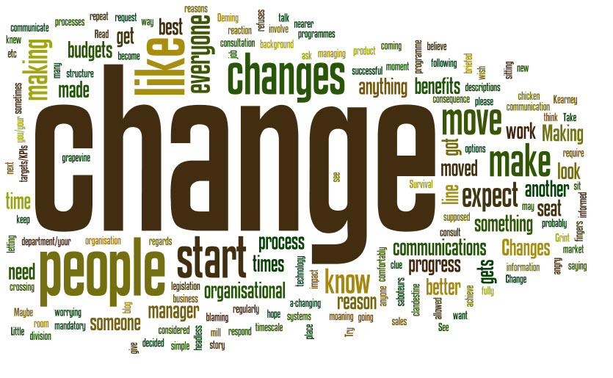
A message from Vish – he listened!
A time for change....
The time has come for us to analyze the way we develop and deliver software to our customers. The tools and processes that have served us well over the past 15 years must evolve as customer demands rise. We recently spent some time identifying gaps in our tools and inefficiencies in our processes. It became quite clear that a change was needed. In order to scale, we are looking to migrate from PTC to the Atlassian family of tools. Atlassian is leading the industry with their solutions and I know there are many of you who are already familiar in working with them.
Notes:
Need work: Ramona

Slide 6
Application Lifecycle Management (ALM) What is it?
Definition
Application Lifecycle Management (ALM) is the supervision of a software application from its initial planning through release including work distribution throughout the process. It also refers to how changes to an application are documented and tracked.
This term will replace Product Lifecycle Management (PLM).
High-level Benefits to the Organization
Rapid response to revenue based functionality for individual clients.
Bug Fixes and Hot fixes will be reduced by feature branching.
Improved quality
Greater efficiency
Notes:
Change from Product Lifecycle Management to ALM
Benefits
Revenue based new functionality for individual clients
Bug fixes
Hot fixes
Needs work: Owner: Ramona

Slide 7
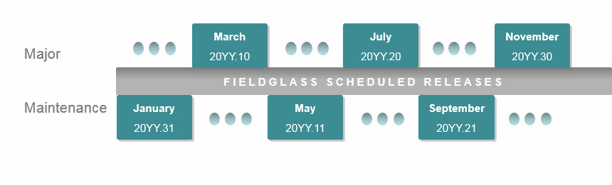
Application Lifecycle Management Let’s Talk Release Cycles – How will they Change?
Today’s Release Cycle
Notes:
Why is there no difference?
Legal obligations around introducing changes to the application require us to provide certain notice and information such as documentation.
Many of our clients and especially partners create their own training programs and documentation, they cannot manage this if we are introducing new functionality more than 3 times per year.

Slide 8
Application Lifecycle Management Let’s Talk Release Cycles – How will they Change?
New ALM Release Cycle
Do you notice the difference?
Notes:
Why is there no difference?
Legal obligations around introducing changes to the application require us to provide certain notice and information such as documentation.
Many of our clients and especially partners create their own training programs and documentation, they cannot manage this if we are introducing new functionality more than 3 times per year.

Slide 9
So...what is changing?
The things that are changing ‘under’ the hood.
Notes:
Transition Slide

Slide 10

So...What is actually changing?
Processes
Tools
Teamwork
Notes:
Needs pic: Owner: Ramona

Slide 11
So...What will change? Benefits To You!
Broken builds will never get to QA - to the release branches (QA)
Tools: feature Branching
Capturing all work “you” are doing – getting credit for all that you do
Process: Streamlining and collaboration
Significantly reduce documentation using best in breed tools
Tools and Teamwork: Requirements Management, product sign-off, Product backlog management, Teams Spaces and increased collaboration.
Reduce Sandbox delays
Tools: Best in breed Tools – Facilitate increased communication and collaboration between Dev/QA/Product Management
Process: Reorder development process so testing and code reviews are completed prior to promotion of code.

Slide 12
So...What will change? Benefits To You!
Better collaboration around the world....☺
Tools: All tools are connected and talk with each other
Moving to the best in breed industry tools.
Tools: Atlassian suite of products (Confluence, Git, Jira)
Find Issues earlier in cycle for our application team to code and test in real time
Process: Reorder the development process so testing and code reviews are completed prior to promotion of code
Reduce technical debt – Bugs/defects/monolithic code
Process: Map and Agile

Slide 13
So...what is actually changing? Processes - Modified Agile Process
More collaborative workflows
New pre-production deploy strategy will be phased in
Entire team can focus on brainstorm design
New terminology
Business Case Management
Issue Tracking workflows
Business Case – Requirement – Issue – Development
Issue Develop Test
Backlog management- adopting tools for better prioritization and assignment of workload
Product Backlog
Business Case Backlog
Issue Backlog
Notes:
Update Tools section if needed. Owner: Mike

Slide 14
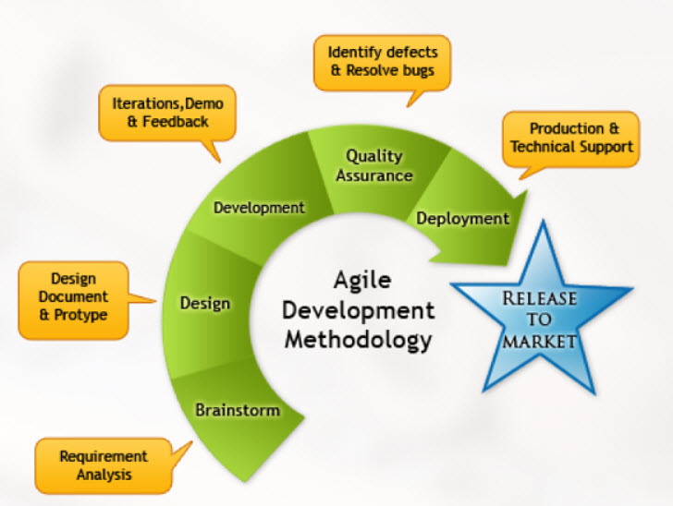
So...what is actually changing? Modified Agile Process
Individual Feature vs Entire Release
Feature Branching
Allows work to be done in parallel; multiple features can exist at any time
Iterative development cycles on the feature
Reorder of testing and development process
Continuous builds
Feature
Notes:
Owner: Mike for text Ramona for pic

Slide 15
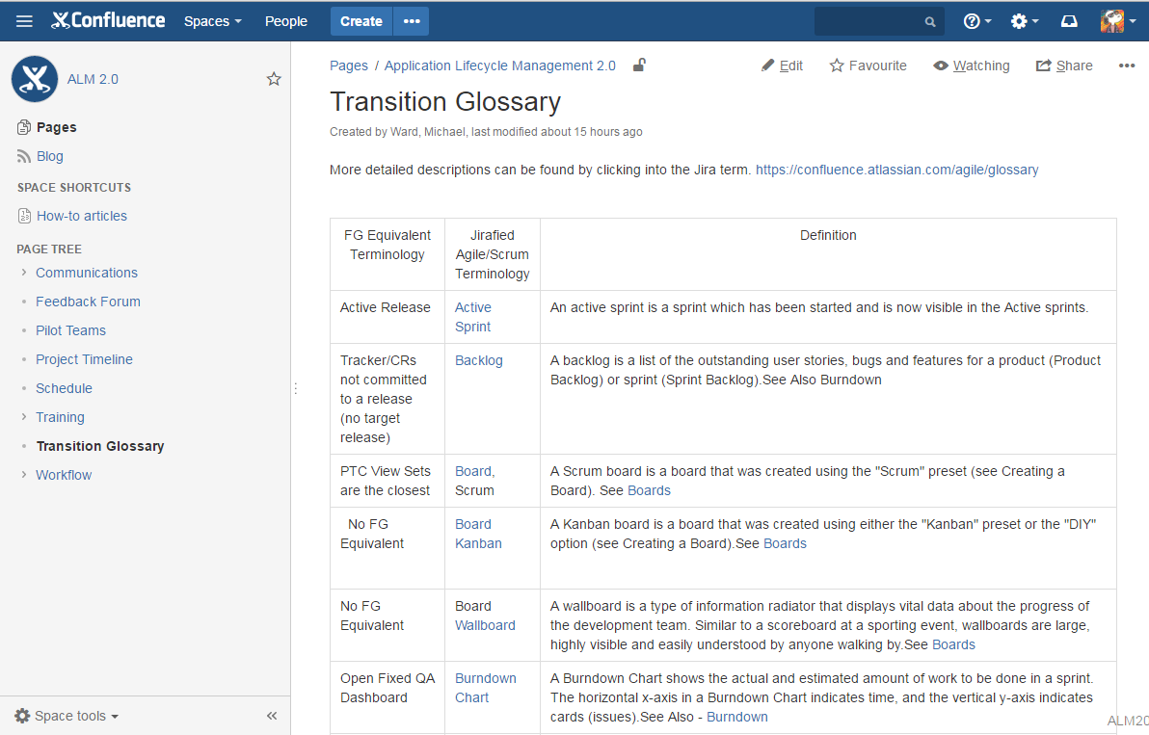
So...what is actually changing? Modified Agile Process
New terminology
We have some new terminology being introduced.
New terminology such as Epics, Story Cards, Points, Bugs
Notes:
Add Visio pic

Slide 16
So...what is actually changing? Processes
Backlog management- adopting tools for better prioritization and assignment of workload
Product Backlog
Business Case Backlog
Issue Backlog
Notes:
Add Visio pic

Slide 17
So...what is actually changing? Tools
Processes -
Updated business case management
Adoption of some Modified Agile Practices (MAP)
Tools
Replacement of Integrity PTC with Git, Jira, and Confluence
Continuous Delivery Workflow
Notes:
Update Tools section if needed. Owner: Mike

Slide 18
Tools
Confluence
Collaborative Wiki
Information Repository
Release Planning
Jira
Issue Tracking and Management
Release Planning
Workload Management
Git etc.…
Source Code Management
Automated Build and Test
Pre Production Deploys

Slide 19
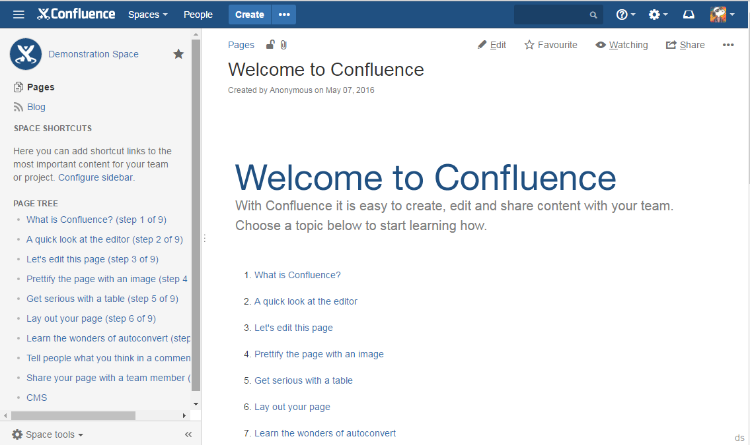
Tools - Confluence
Confluence
Collaborative Wiki
Information Repository
Release Planning

Slide 20
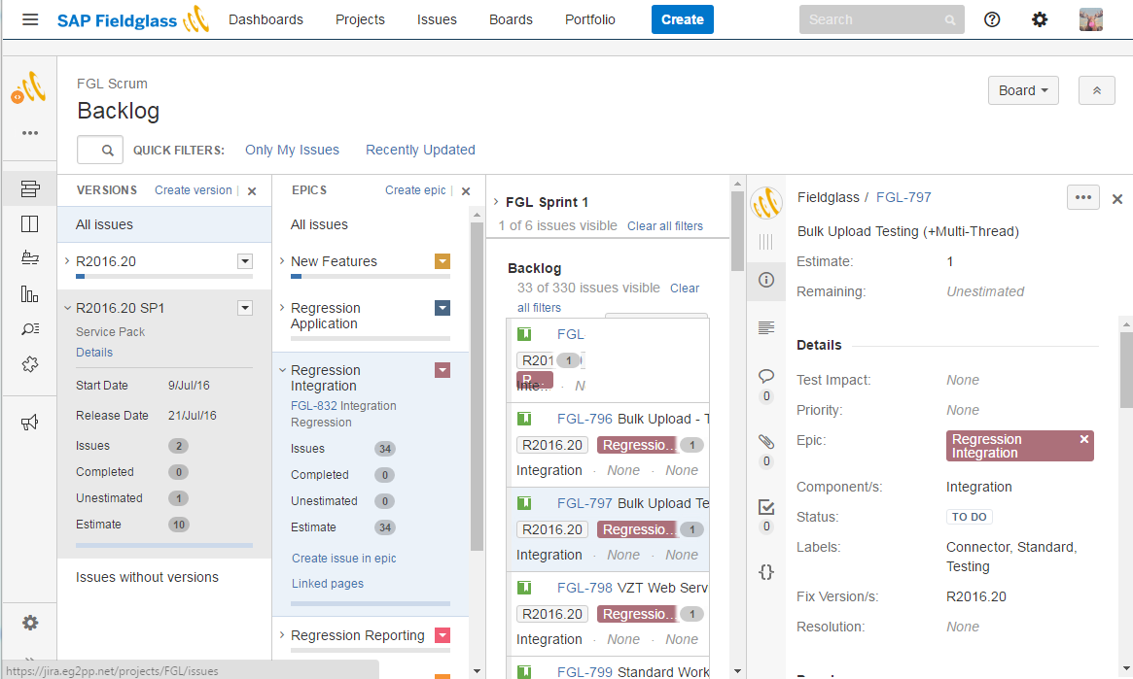
Tools - Jira
Jira
Issue Tracking and Management
Release Planning
Workload Management

Slide 21
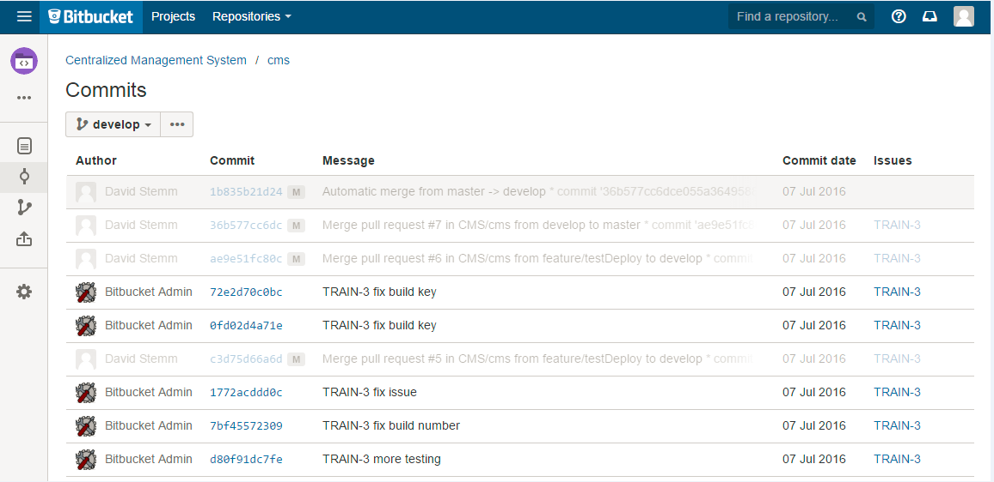
Tools - Git
Git etc.…
Source Code Management
Automated Build and Test
Pre Production Deploys

Slide 22
So...What is actually changing? Tools: Source Code and Build/Deploy Tools
Git
Source Code Management/Version Control
BitBucket
Web interface into our shared Git repositories
View source code, changes, diffs for code reviews, merge (pull) requests, etc.
Bamboo
Automated build tool with a web interface
Runs automated tests, and builds for deployment
Functionality is equivalent to Jenkins
Deployer
Existing Fieldglass application that manages pre-production deployment.
SCM Team wrote and maintains this application
Will need to be modified to use the Bamboo generated builds.
Notes:
Owner: Mike

Slide 23
So...What is actually changing? Git Training is in Progress
Most folks will have completed the initial 1 hour setup and introductory training by the end of July
Please contact your site trainer if you have not completed this training
We are creating walkthroughs on common scenarios as an alternative to the Lynda training
These should be ready by the end of the month and available in Confluence on the Git Training pages
Non-developer use cases will be covered as well
The training repository has code to play with
Please clone this repository to work through the training scenarios
We will be creating branches to match the FG branching policy
We will be creating bamboo build jobs against those branches
We would like everybody comfortable with the training scenarios by the end of August
There are updated Git Office Hours on confluence to answer any of your questions or resolve issues.
Notes:
Owner: Kevin

Slide 24
So...What is actually changing? Teamwork
Processes -
Updated business case management
Adoption of some Modified Agile Practices (MAP)
Tools
Replacement of Integrity PTC with Git, Jira, and Confluence
Continuous Delivery Workflow
Teamwork
Collaboration
Efficiencies
Notes:
Owner: Mike and Kevin

Slide 25
So...What is actually changing? Teamwork
Increase collaboration with closer interaction between BA/Dev/QA around the world.
More traceability using tools between requirement and development
Elimination of hard stops between releases phases because it is more Iterative
Reduction of duplication of work due to shared ownership of deliverables
Everyone has a voice leading to higher quality outcomes
Notes:
Details of teamwork – Owner: Mike

Slide 26
What we are not doing! ☺
Application Lifecycle Management

Slide 27
What we are not doing!
Not changing production deploy cycle
Not going to adopt a full agile methodology
Not going to continue to use PTC after the transition is complete
Not going to continue doing things the exact same way as we have

Slide 28
Project Management Details
Application Lifecycle Management

Slide 29
Project Management ALM Implementation Team
Stakeholders
Git/Bitbucket: Shivram Naik
Jira/Confluence: Mike Ward
Product Design: Marcia Hulan
Product Backlog and Intake of New Initiatives: Deanna Freise
Executive Sponsors
Dan Bell and Vish Baliga
Implementation Team
London Janardhana, Dinesh Helgers, Judith
Mumbai Kulkarni, Anand Jaywant, Rakesh Vijay Nandlaskar, Kirti Bhalchandra
US Wegner, Kristen Mack, Gary Solls-Vitor, Juanita Kandukuri, Meher Hegland, David Stemm, David Keller, Kevin
Bangalore Rajashekar, Mahesh Kumar Settipalli, Vinay Gopal Manjunatha Mohan, Lakshminarasimha
Pune Talwalkar, Dhanashree Mahesh D
Israel
Glasnar, Shalvia
Notes:
Add list of all the folks and rolesOwner: Ramona

Slide 30
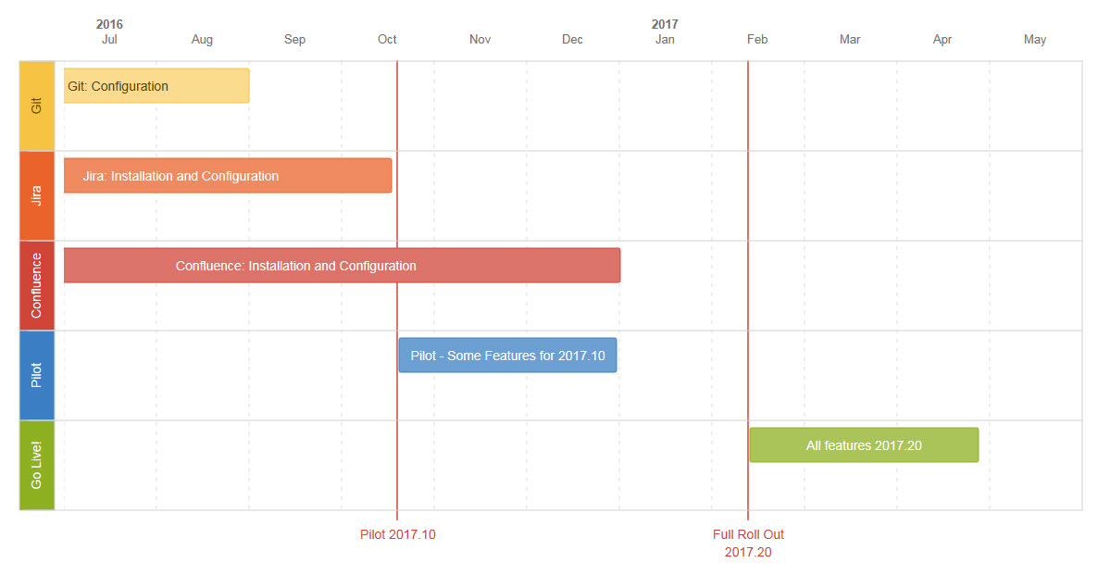
Project Management High Level Timeline for Major Milestones (subject to change) ☺
Notes:
Major Milestone Timeline – Owner: Ramona

Slide 31
Project Management What’s Next
What to Expect – Communication Program
Weekly communications
On-demand recorded sessions
Information Blog
Major Milestone announcements
Discussion Forum
A place to find it all...
Notes:
Try and make picture of above. Owner: Ramona

Slide 32
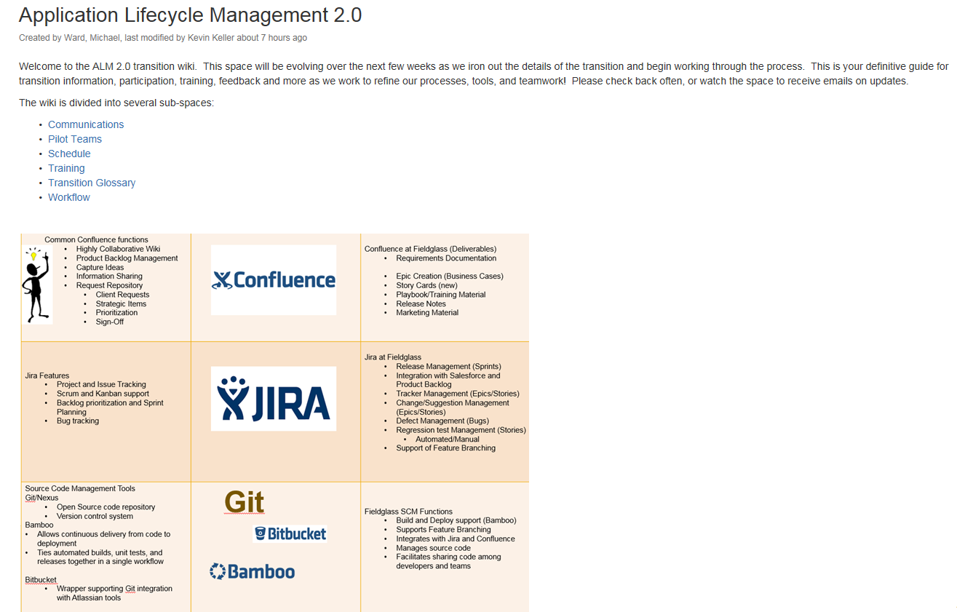
Project Management Everything you need to know in one place!
Where to find more Info!
A confluence site has been set up as the primary place to go to for ALM project information/training.
Login information will be provide in an email communication that will be distributed on Thursday, after the final session.
Notes:
Owner: Kevin and Mike

Slide 33
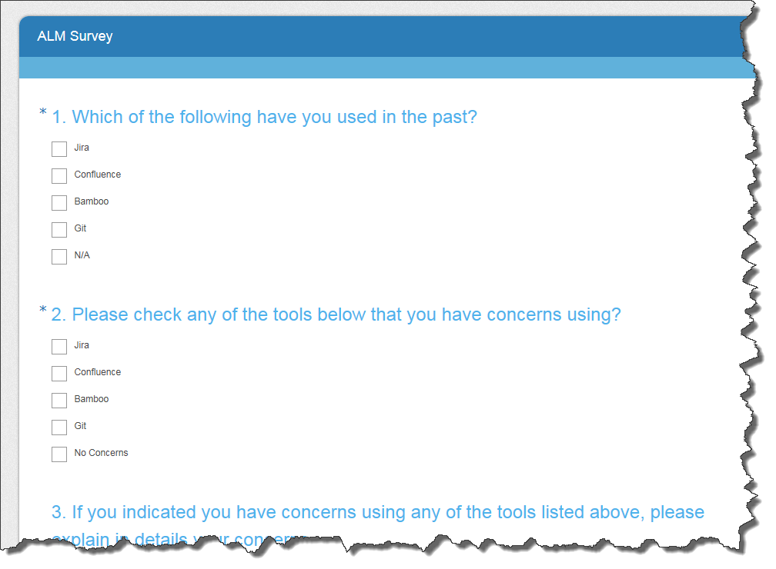
Project Management Survey and Voting for your team Name
Survey
We want to hear from you – tell us what you think.
Make your voice heard!
Vote for your Feature Branching Team Name!!
At the end of the survey there will be 3 team name options for you to vote on.
You have to log in and complete the survey to play! ☺
Notes:
Survey: Owner???
What doe we want to call our teams? MAP Teams – Modified Agile Process teams; FIT – Fieldglass Iterative Teams; RAP – Revised Agile Process Teams Owner: Ramona

Slide 34
Questions & Answers

Slide 35
Thank you

